Slide 1
Waivers Explained
In Plain English
Marie Tennant
MassDEP
July 2019
Program.Director-DWP@mass.gov

Slide 2
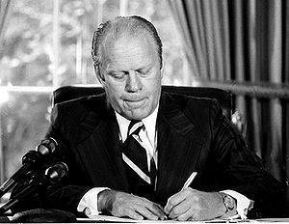
It all started in 1993 Safe Drinking Water Act of 1974 NPDWR Phase II and V
Approved monitoring waivers for SOC, VOC, and IOC
We really want you to save money!
Two score and five years ago….
Notes:
Feds National Primary Drinking Water Regulations
Gerald Ford
Synthetic, Volatile, and Inorganic

Slide 3
Compliance Cycle and Compliance Period
2020 Nine-year compliance cycle 2028
2020
2021
2022
2023
2024
2025
2026
2027
2028
Community and Nontransient Noncommunity Systems
Volatile Organic Compounds
Synthetic Organic Compounds
Inorganic Compounds
No source can go nine years without benchmark testing
Notes:
We will be starting our 4 th compliance cycle.
1993-2001 2001-2010 2011-2019 2020-2028
Waivers are for the source, not the PWS.
PWS apply and DEP reviews and grants or not

Slide 4
How to Pass the Waiver Test
You must apply for waivers
Must pass source protection test
Must pass the water quality test
Individual sources are waivered, not the PWS

Slide 5
Source Protection Review
Water Quality
Review
Detailed review of lab results:
Holding times,
lab methods,
sampled at correct times,
results/detects of sampling,
manifolded sources,
Composite sampling
No need to send in lab reports
Identify any sources of contamination
Any use, storage, manufacturing, etc. of chemicals in the source protection zone
Geology of the area
Rail roads, roads, parking lots, farms, etc. in/near the source protection zone
Must meet well construction codes
Notes:
Remember waivers are for sources not PWS

Slide 6
Water Quality Review VOC
Initial monitoring is to sample for 4 consecutive quarters after that, annual testing is required.
Waivers reduce sampling to once every three-year period.
Benchmarking – not an issue
Trihalomethane compounds are excluded.
Source cannot have any historical detects.
Notes:
Already test once a year so you will have benchmarking already done.
Trihalomethanes include chloroform, bromoform, chlorodibromomethane, bromodichloromethane
One historical detect in 10 years can be allowed for lab anomalies
Chloroform, bromoform, chlorodibromomethane , bromodichloromethane.
Voc are methanes benzenes ethylene…

Slide 7
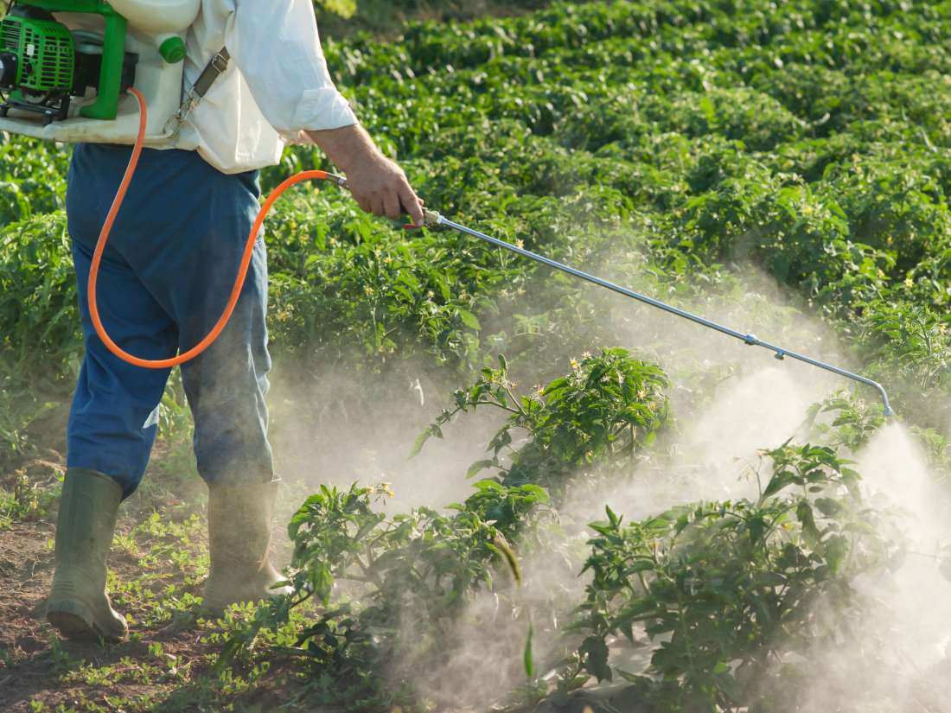
SOC
Water Quality Review
Initial testing is 4 consecutive quarters in three years.
After that, larger systems >3300 test 2Q in the same year every 3-year period. The smaller systems =<3300 test once per 3-yr period.
An SOC waiver means you do not sample for the 3-year compliance period. But remember the benchmarking.
SOC waiver can be renewed in the next compliance period.
Single analyte testing may be done for a detect
Diquat, endothall, glyphosate, and dioxin have a statewide waiver
and EDB and DBCP waived for surface sources only.
Notes:
Depending on the lab method used it may not be cost effective to test for a single analyte.
The 4 are herbicides
Ethylene dibromide EDB used as anti-knock in fuels - dibromochlropropane DBCP used soil fumigant for crops
Chloroform, bromoform, chlorodibromomethane , bromodichloromethane.

Slide 8
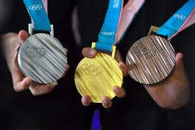
Water Quality Review IOC
IOC testing for groundwater sources is once in 3 years and surface is once each year.
An IOC waiver reduces sampling to once/9-year cycle (benchmarking)
Once you get an IOC waiver it is good for the entire 9 years.
Single analyte testing for IOCs over 1/2 MCL
No waivers for sodium, nitrate, nitrite
State-wide waiver for asbestos but… do you have A/C pipes?
Notes:
First have to explain the photo, International Olympic Com IOC are metals antimony barium cadmium mercury
So buy 1 get two free is not a bad deal.
Waivers for less that ½ MCL over ½ can do single testing
A/C (asbestos) pipe have to test in distribution lines.

Slide 9
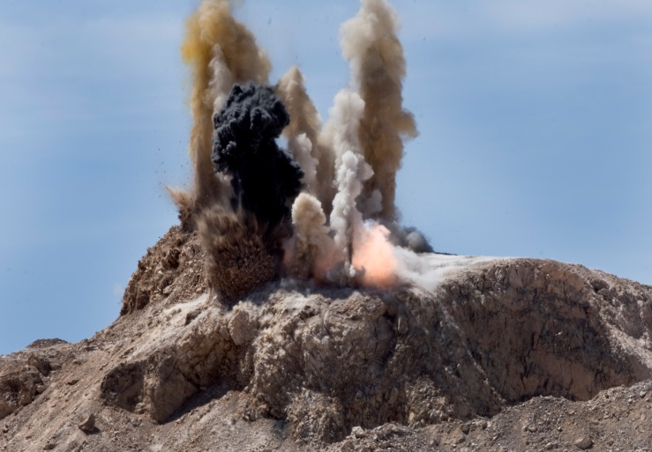
Perchlorate
Water Quality Review
Initial testing for groundwater is once in April and in September. Surface waters test 4 consecutive quarters.
After that, all sources test annually in the 3rd quarter.
An perchlorate waiver reduces sampling to once in the 3-year period.
And you do have to reapply every three years for perchlorate.
A detect up to 0.5 ppb (1/4 MCL) is now acceptable.
Notes:
Pulled out of the IOC suite and handled separately
Again buy one get 2 free.

Slide 10
Even though sources are handled individually…
Manifolded Sources
Source 1 has a hit and source 2 does not but they are manifolded.
Both sources will then not be eligible for a waiver.
Composite Lab Samples
If one lab sample is reporting on two or more sources then the test results are recorded for each of the sources.
Note on
Replacement Wells
Waiver status can be grandfathered onto the replacement well if it is within 50 feet of old well and draws the same quantity of water.

Slide 11
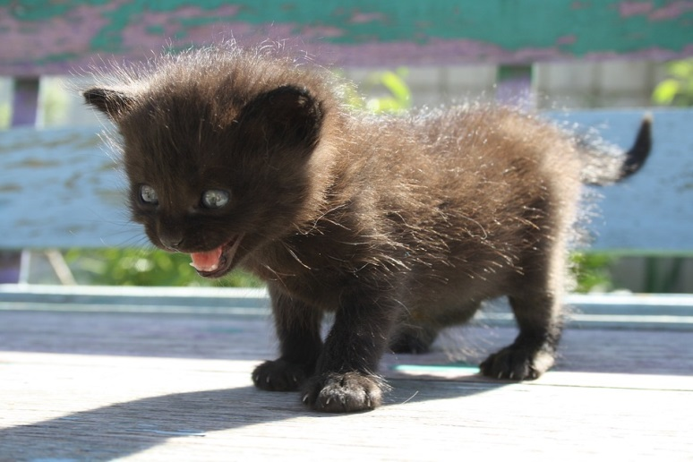
The application form isn’t all that bad to fill out.
Section A is just info about your system – easy enough.
Section B is asking what source you want a waiver for and what waiver you are requesting. Please use the Source ID Number (such as 02G, or 3S). The actual name of the well is not that helpful when processing the application.
Section C/D is a little different story. It’s the Source Protection Part. You have to fill out a Section C for each GW source (Section D for SW sources). Yes. You’ll probably have to make copies.

Slide 12
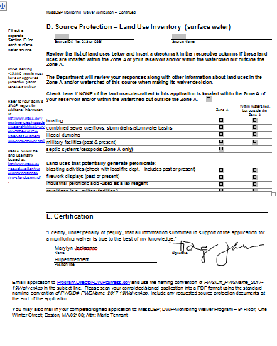
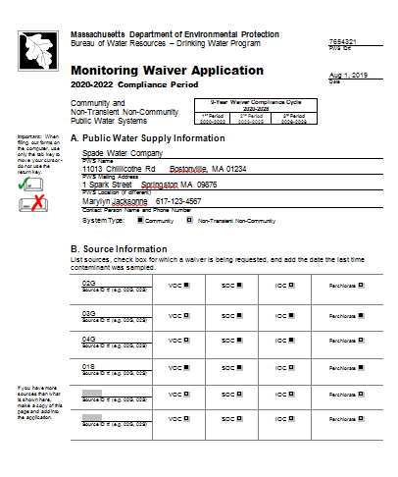
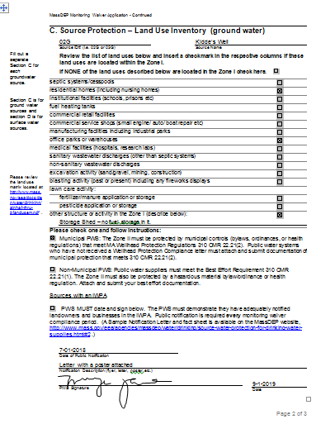

Slide 13
After you submit your application
You are done.
Marie.Tennant@mass.gov
Catherine.Sarafinas-Hamilton@mass.gov

